Slide 1







Trend Analysis Of Programming Languages and Databases
Atanu Chakraborty
DATE: 04.08.24

Slide 2




OUTLINE
Executive Summary
Introduction
Methodology
Results
Visualization – Charts
Dashboard
Discussion
Findings & Implications
Conclusion
Appendix

Slide 3

EXECUTIVE SUMMARY
Programming Language Trend Comparison: Current vs Future
Findings
Implications
Database Trend Comparison: Current vs Future
Findings
Implications
Dashboard
Job Opportunities
High-Paying Programming Languages

Slide 4

INTRODUCTION
Objective: Analyze evolving trends in programming languages and databases.
Significance: Understand their impact on technology and career opportunities.
Scope: Cover popular languages, emerging technologies, and industry shifts.
Expected Outcomes: Identify key trends and forecast future developments.
New roles and skills in demand.
Insights for applying trends to project development and strategic planning.

Slide 5

METHODOLOGY
Collect data from various source by using Python.
Data Wrangling by using Python’s Pandas library.
Data Analysis by using Python’s Pandas library.
Data Visualization By using Python, Excel and IBM Cognos
Charts
Dashboard

Slide 6
RESULTS
Results are explained in below slides➔

Slide 7
PROGRAMMING LANGUAGE TRENDS
Current Year
Next Year

Slide 8
PROGRAMMING LANGUAGE TRENDS - FINDINGS & IMPLICATIONS
Findings
JavaScript hold its position year by year.
Python’s popularity is increasing daily.
PHP and C++ are becoming less popular over time.
Implications
Popular languages like Python and JavaScript offer more job opportunities.
High-demand languages lead to better salaries.
Learning emerging languages ensures ongoing industry relevance.

Slide 9
DATABASE TRENDS
Current Year
Next Year

Slide 10
DATABASE TRENDS - FINDINGS & IMPLICATIONS
Findings
PostgreSQL’s popularity is increasing over time.
MySQL’s popularity has slightly decreased.
Oracle's popularity is gradually declining.
Implications
Businesses may switch to cost-effective databases like PostgreSQL, reducing IT expenses.
Increased demand for PostgreSQL skills (e.g., in startups) as MySQL and Oracle skills decline.
Companies like Oracle must innovate to compete with rising alternatives such as PostgreSQL.

Slide 11

DASHBOARD
SURVEY DASHBOARD- IBM COGNOS

Slide 12
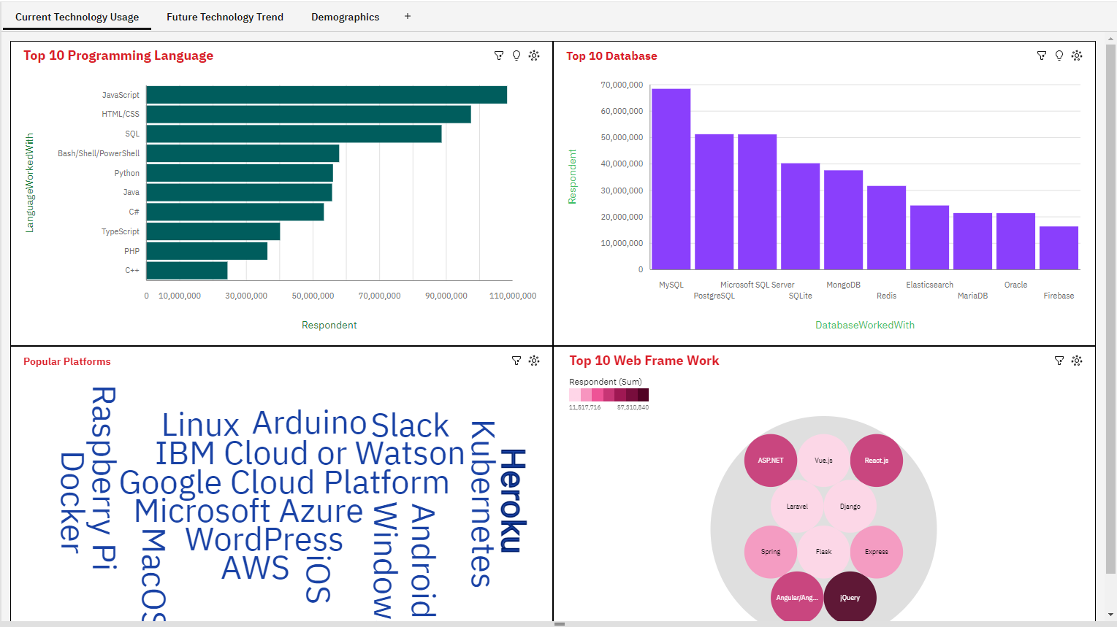
DASHBOARD TAB 1

Slide 13
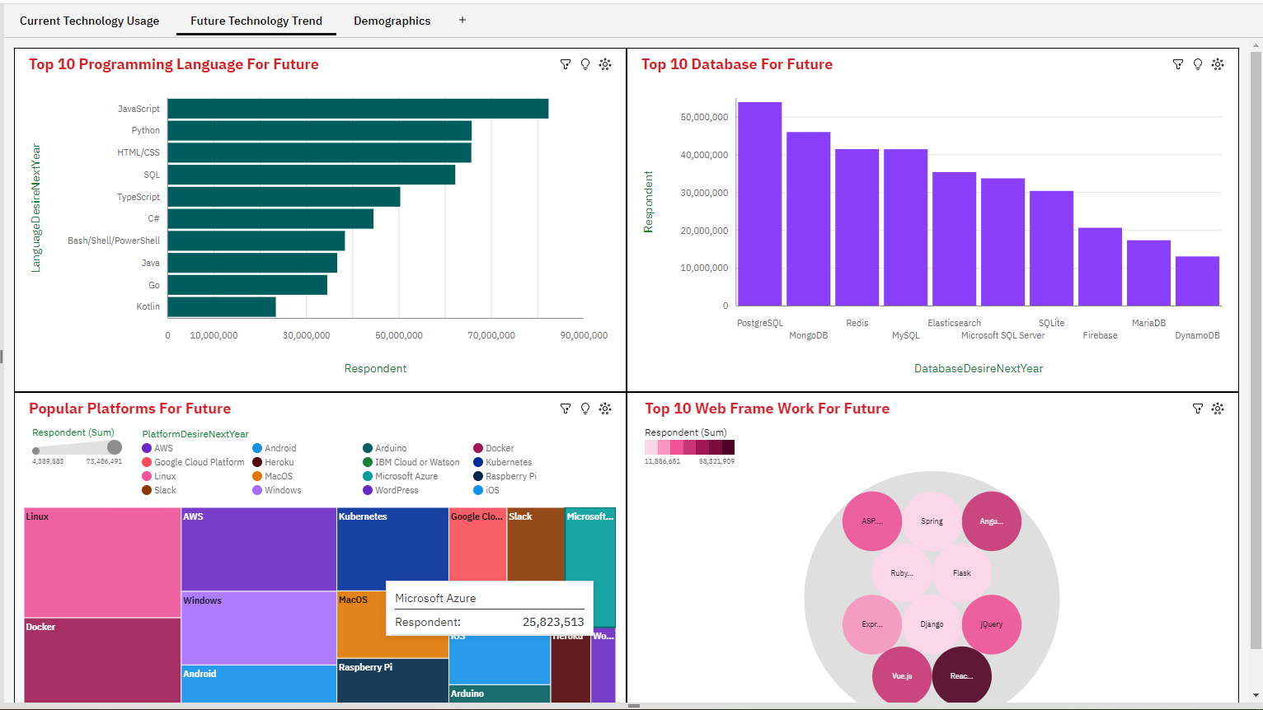
DASHBOARD TAB 2

Slide 14
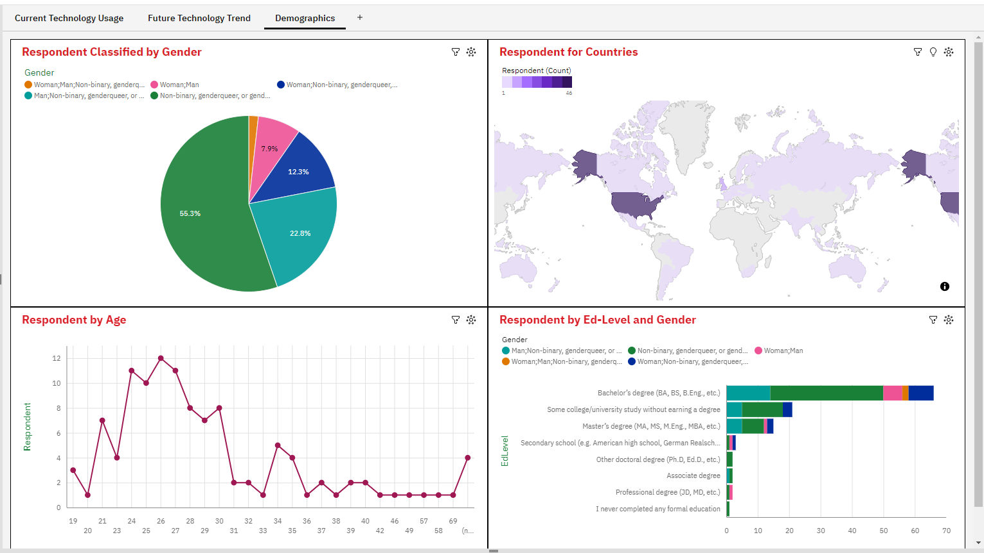
DASHBOARD TAB 3

Slide 15
DISCUSSION
Discussions explained in below Slide➔

Slide 16
OVERALL FINDINGS & IMPLICATIONS
Findings
Python and JavaScript dominate the current market.
Relational databases are current favourites. Multi-Model and Cloud-Native databases are becoming more popular.
Companies are adopting newer programming languages and databases to meet modern demands.
Implications
Transition to newer languages and databases for better performance.
Use cloud-native databases to enhance scalability and reduce management.
Integrate real-time data processing for better decision-making.

Slide 17

CONCLUSION
Python and JavaScript are popular now, but Go is the future of programming.
Multi-model and cloud-native databases are changing data management.
Adopting these new technologies is essential to stay competitive.
Using advanced data processing leads to smarter decisions and innovation.

Slide 18

APPENDIX
Two additional charts included in below Slides:
Bar Chart Of Job Postings
Bar Chart Of Popular Languages Salaries

Slide 19
JOB POSTINGS

Slide 20
POPULAR LANGUAGES

